Slide 1
WhatNext GPT
Team Life_Hacks
Divya Balakrishnan
Aharshraj Gunasekaran

Slide 2
PROBLEM :
There are growth of technologies with including AI, But still the students facing difficulties in choosing their career path.
There are many manpower consultancies available in the market but there are many scams and not in an easier approach to the students.

Slide 3
SOLUTION :
Generative AI can be a solution for it, because the growth of ChatGPT is a biggest trending in tech field.
Why can it become a solutions for the career consulting
We are building a platform for the user’s who have their interest in the IT Field(As of now).
We are suggesting them the correct course to study and allowing them to track their learning progress and at a certain point they fulfilled the courses studies their profile will be visible to the companies.

Slide 4
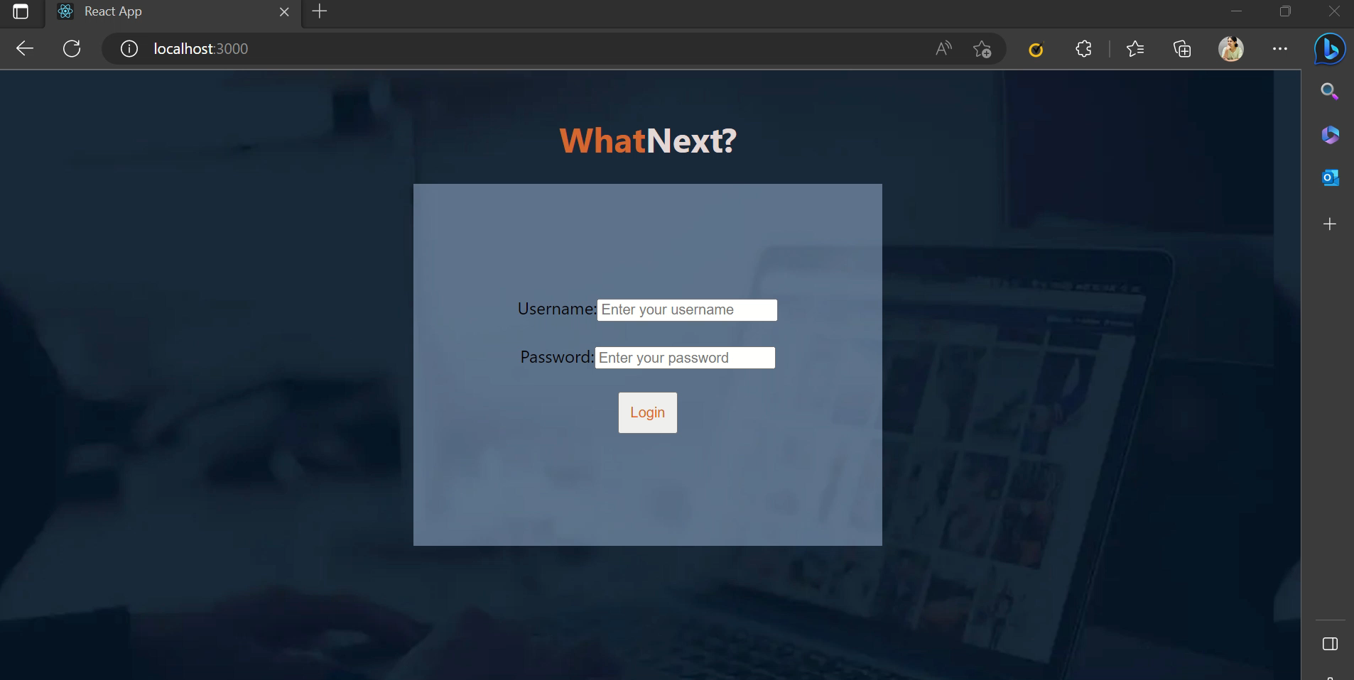
DEMO :

Slide 5
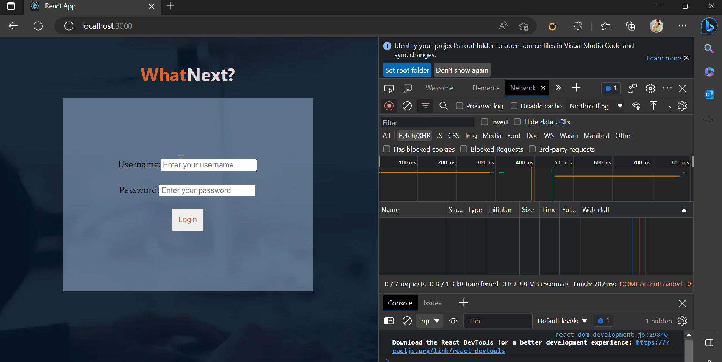

Slide 6
Future Work
At the Point of Technical aspects, we have planned the data and courses which we got from the openai API, analyze it from the google-trends-api and using the neural networks, the data will be trained and the best course will be suggested to the student.
And the competitive challenges will be conducted and based on the marks the profile will move to the companies with appropriate priorities.

Slide 7
THANK YOU!
WhatNext GPT | Team Life_Hacks

